Slide 1

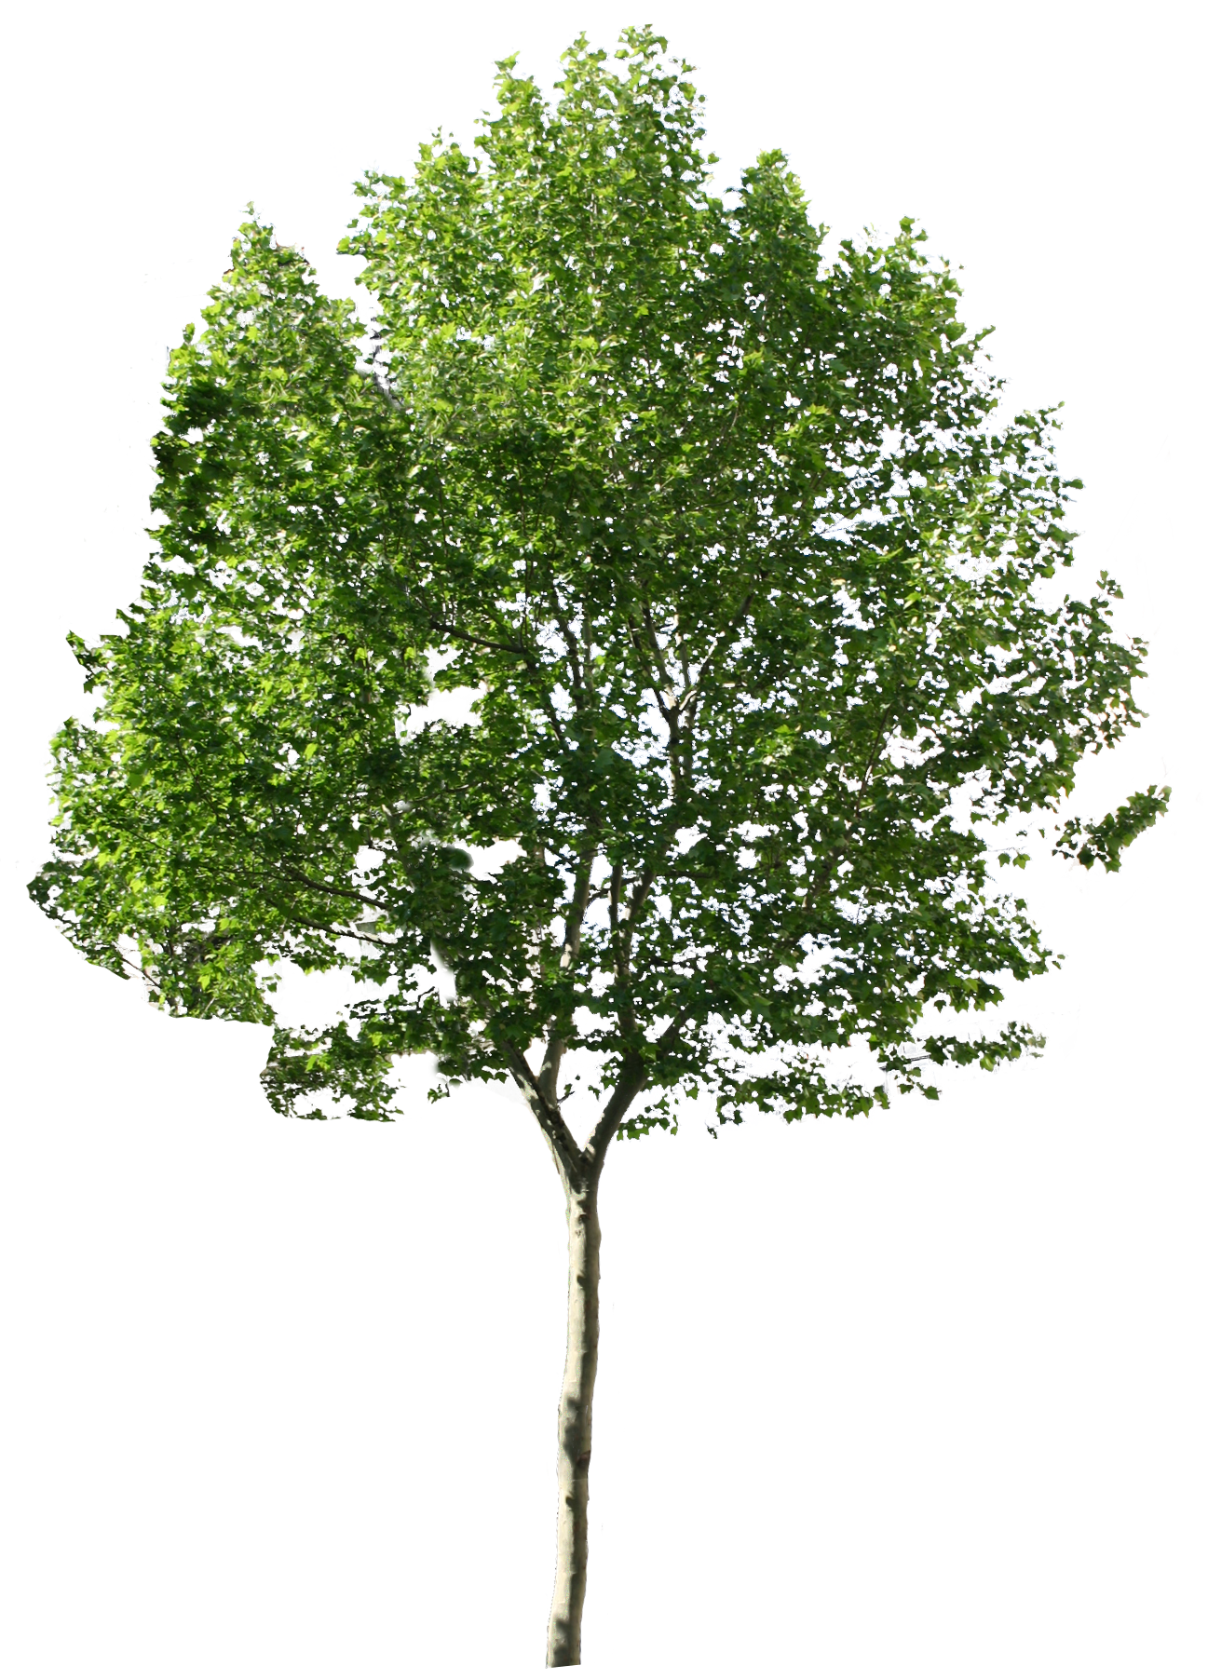


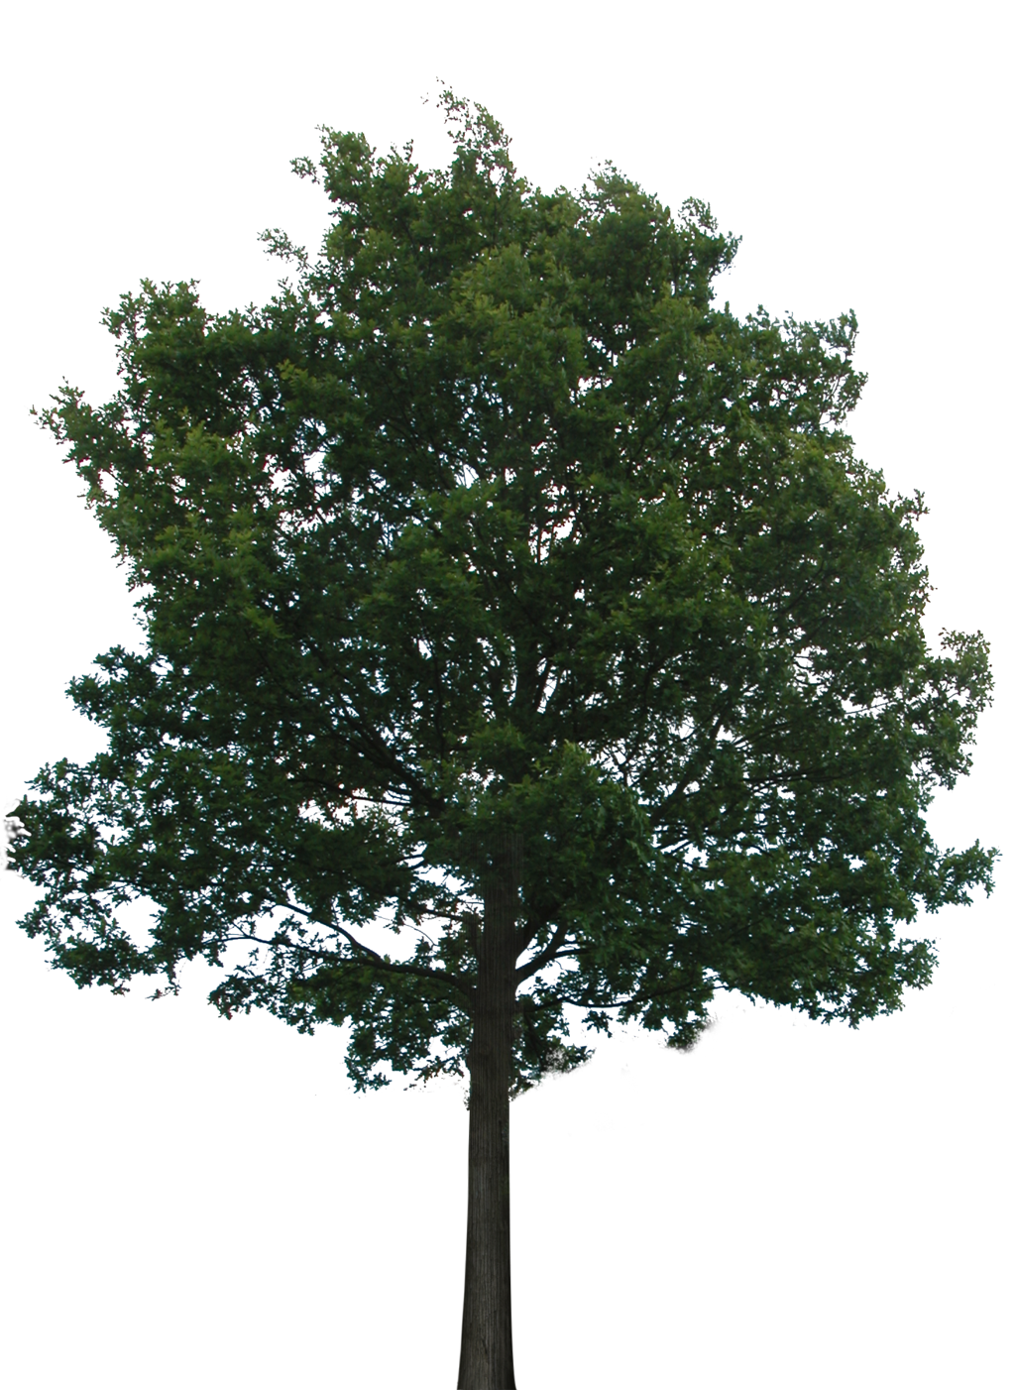
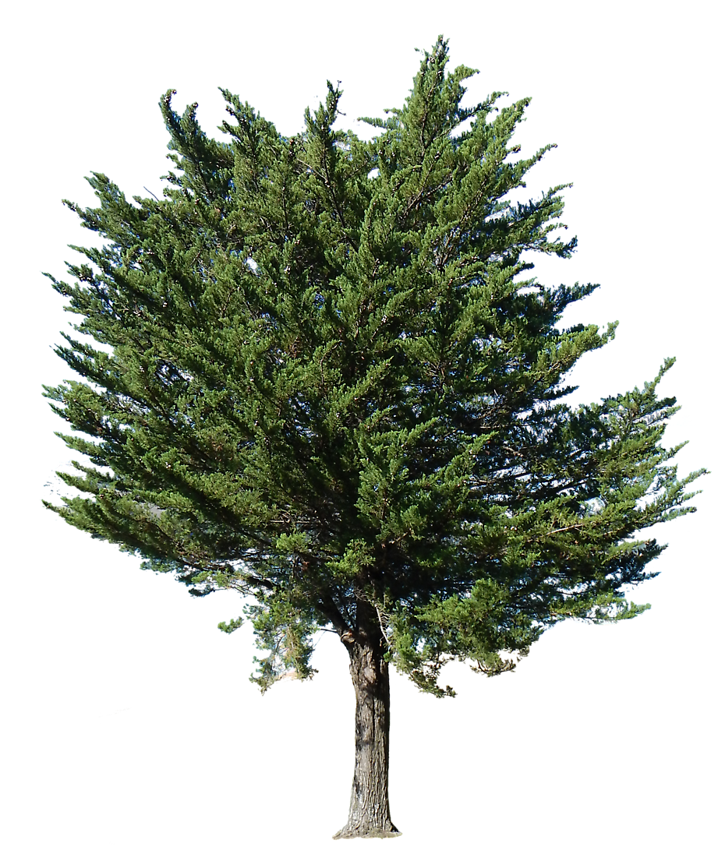

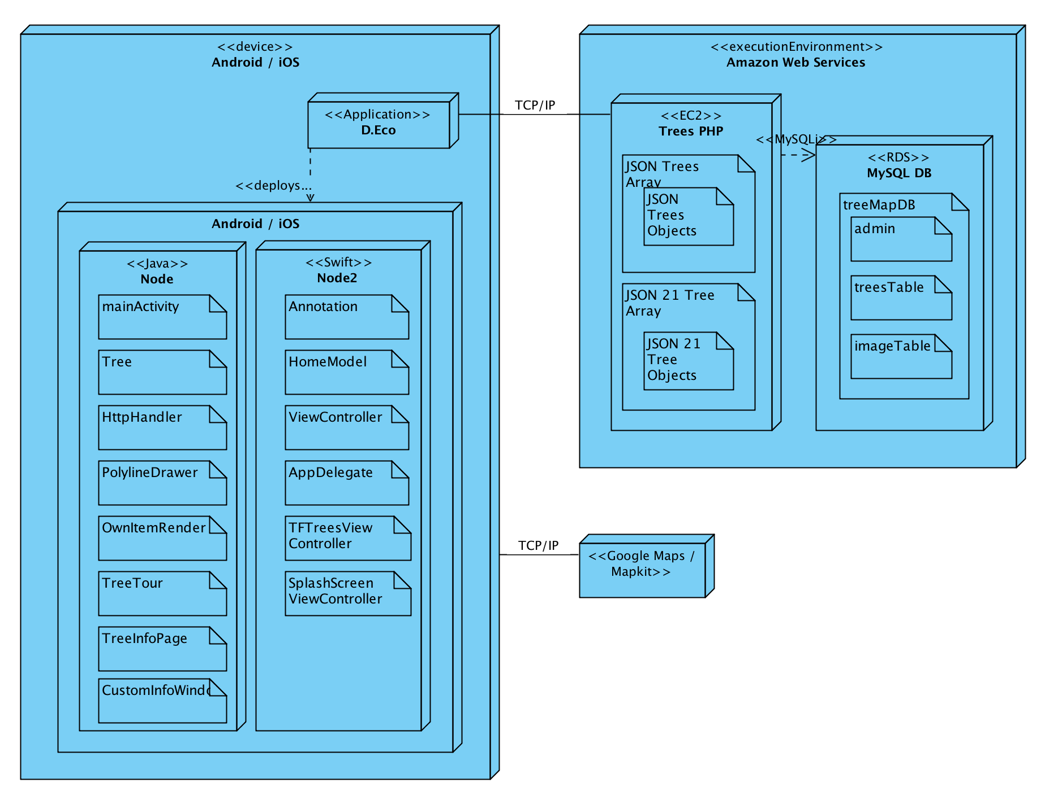
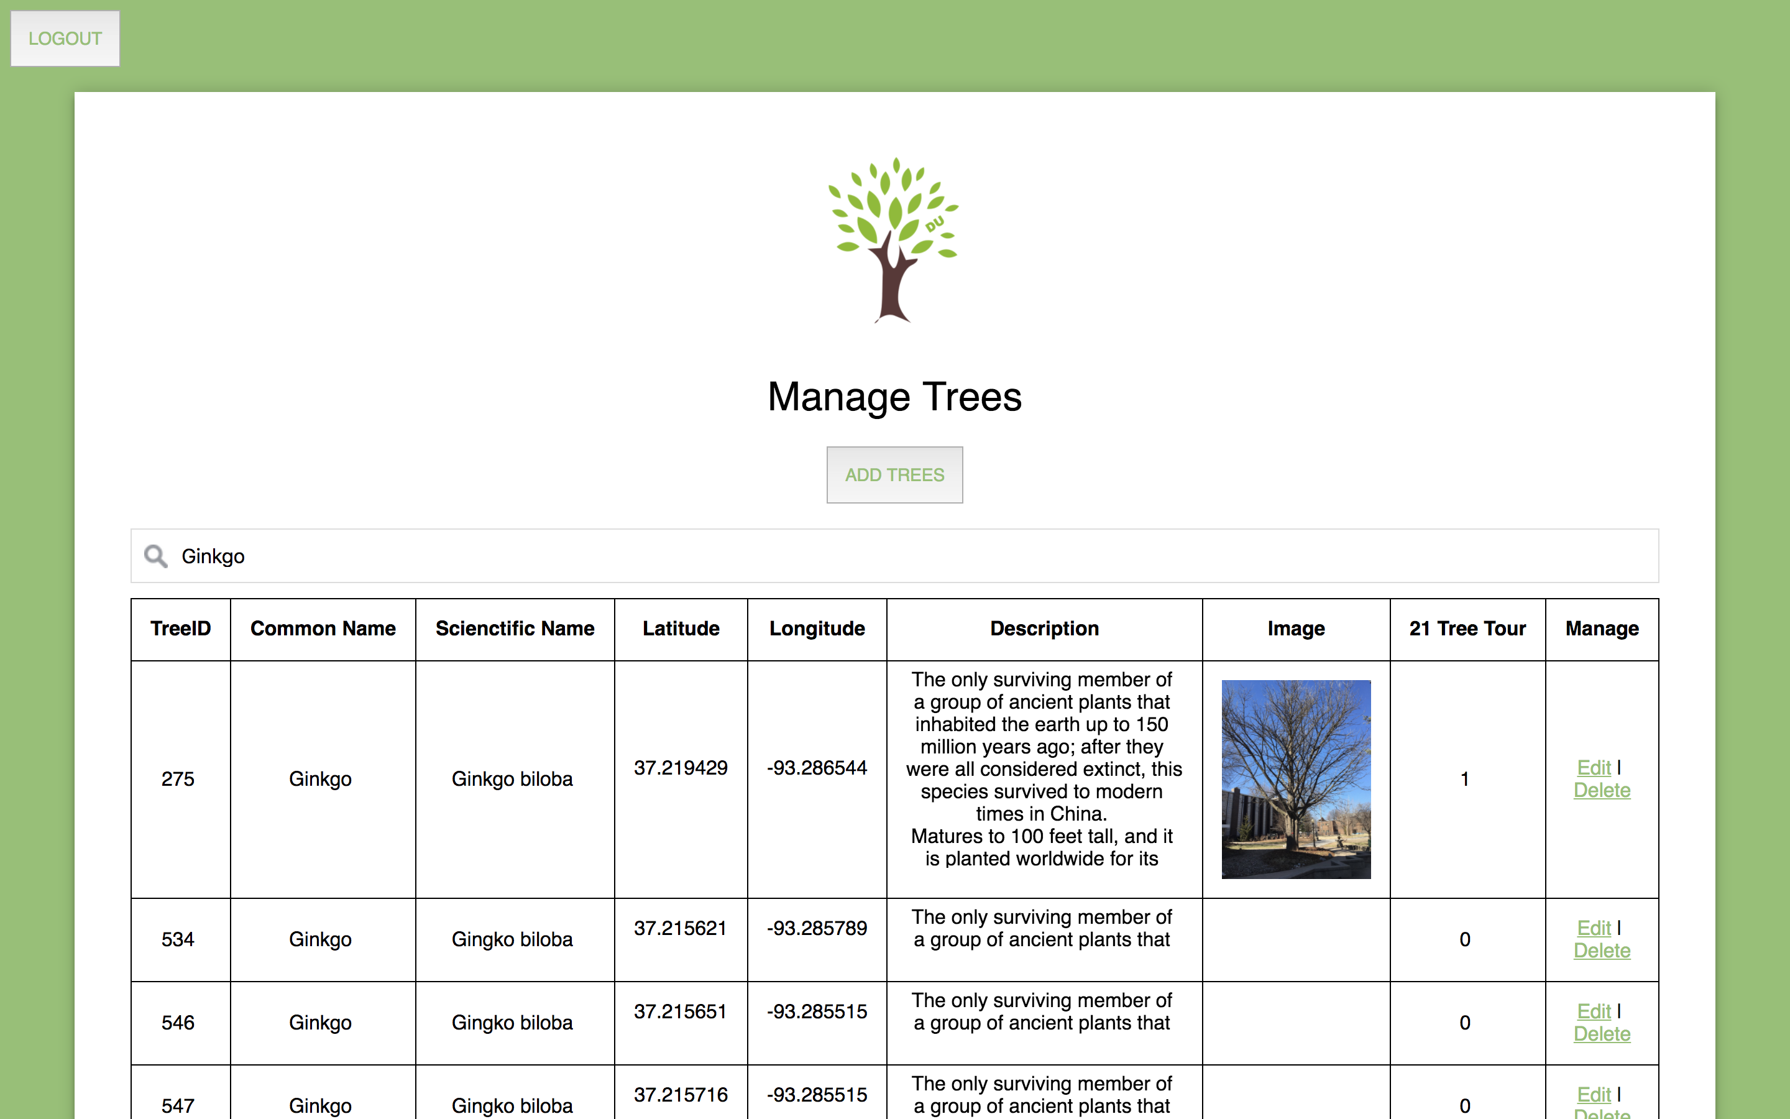
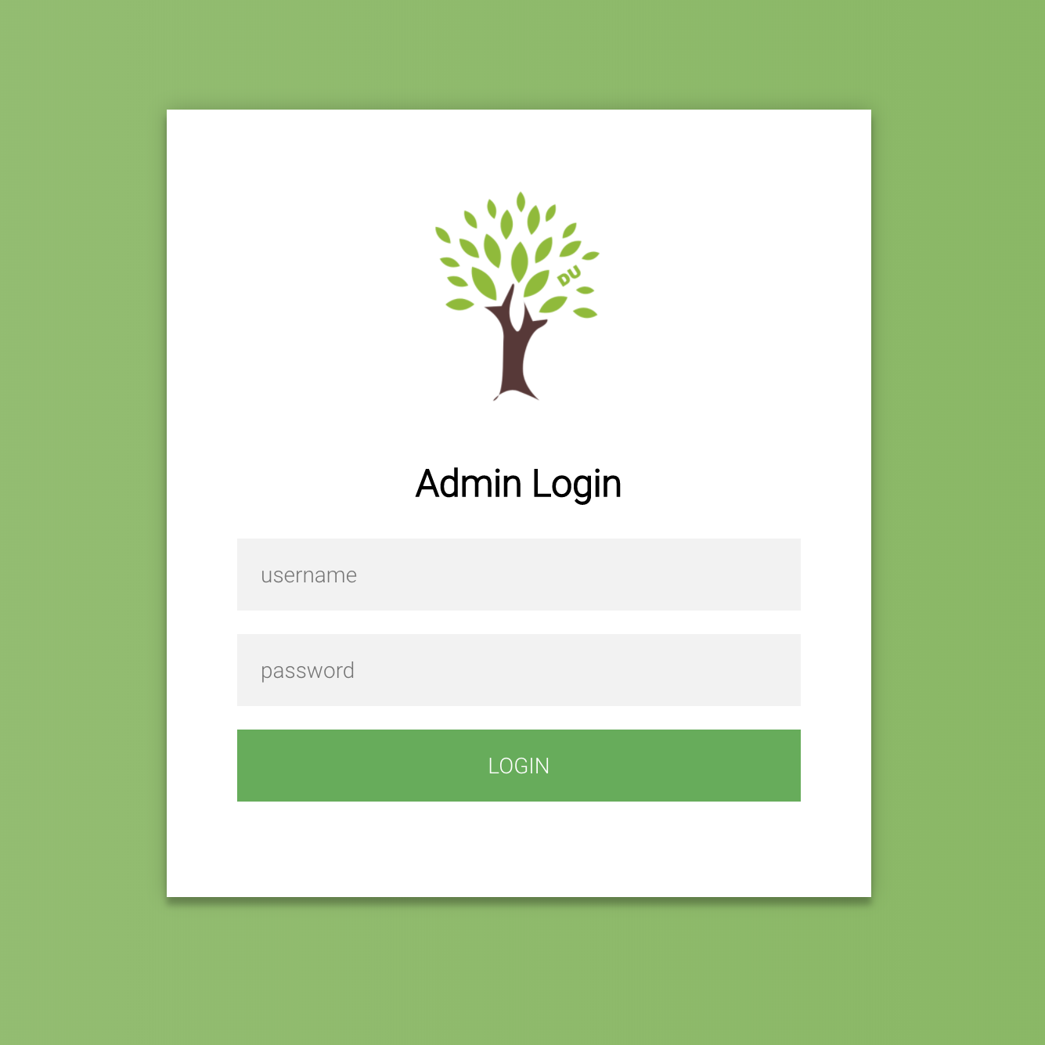
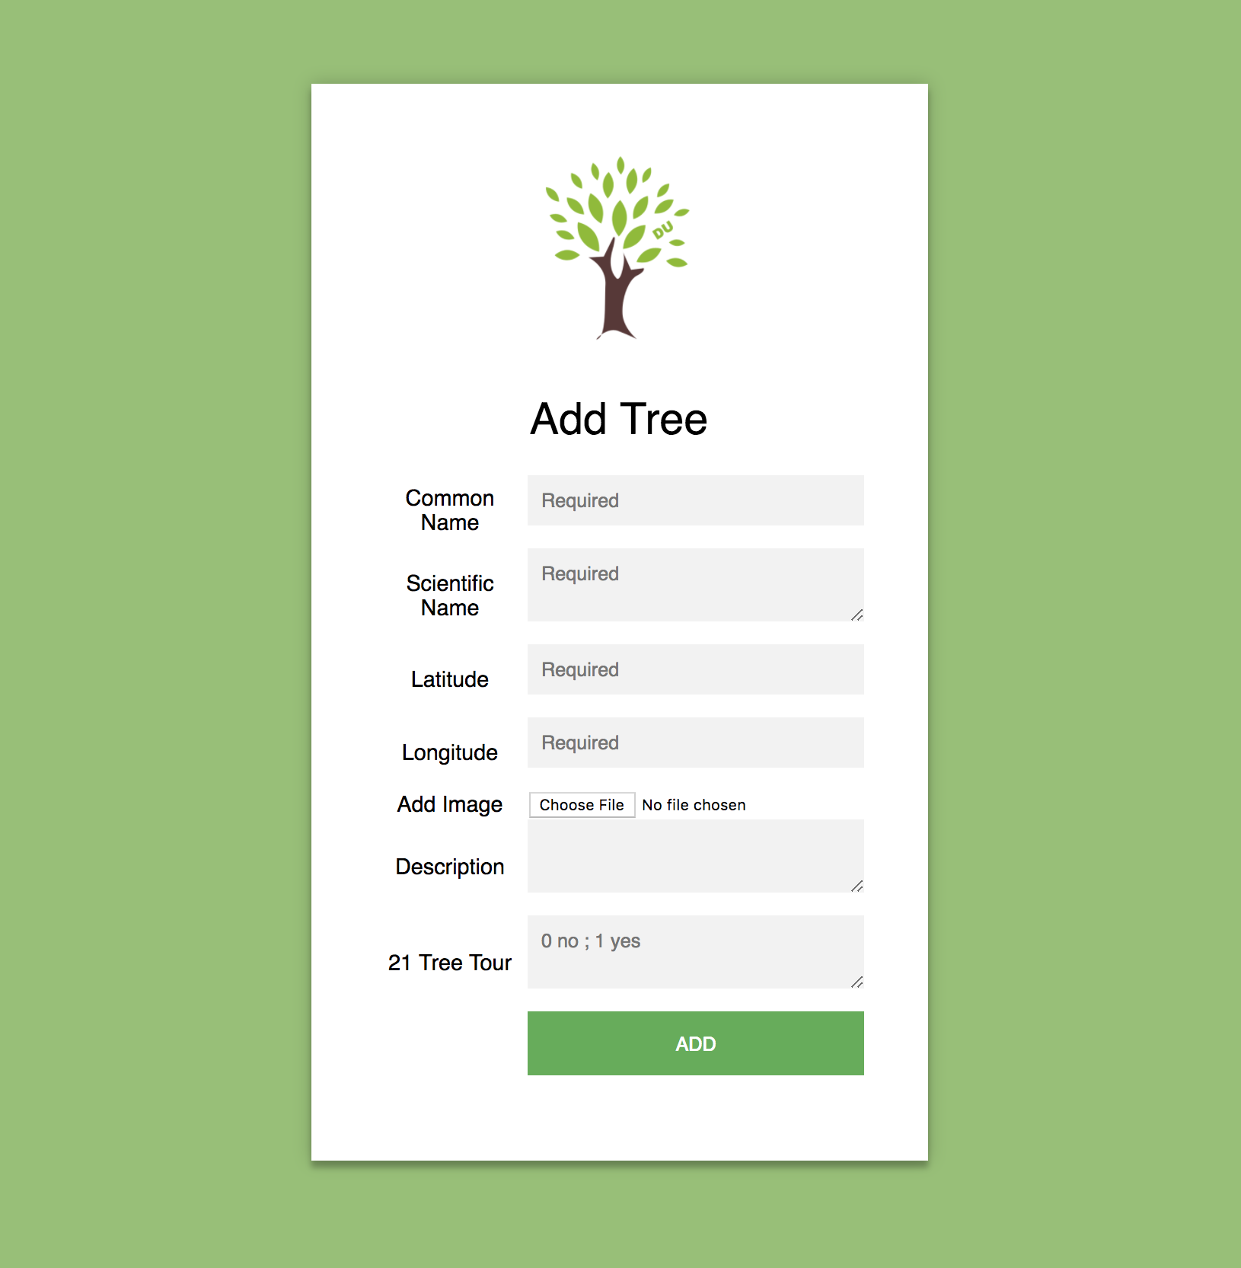
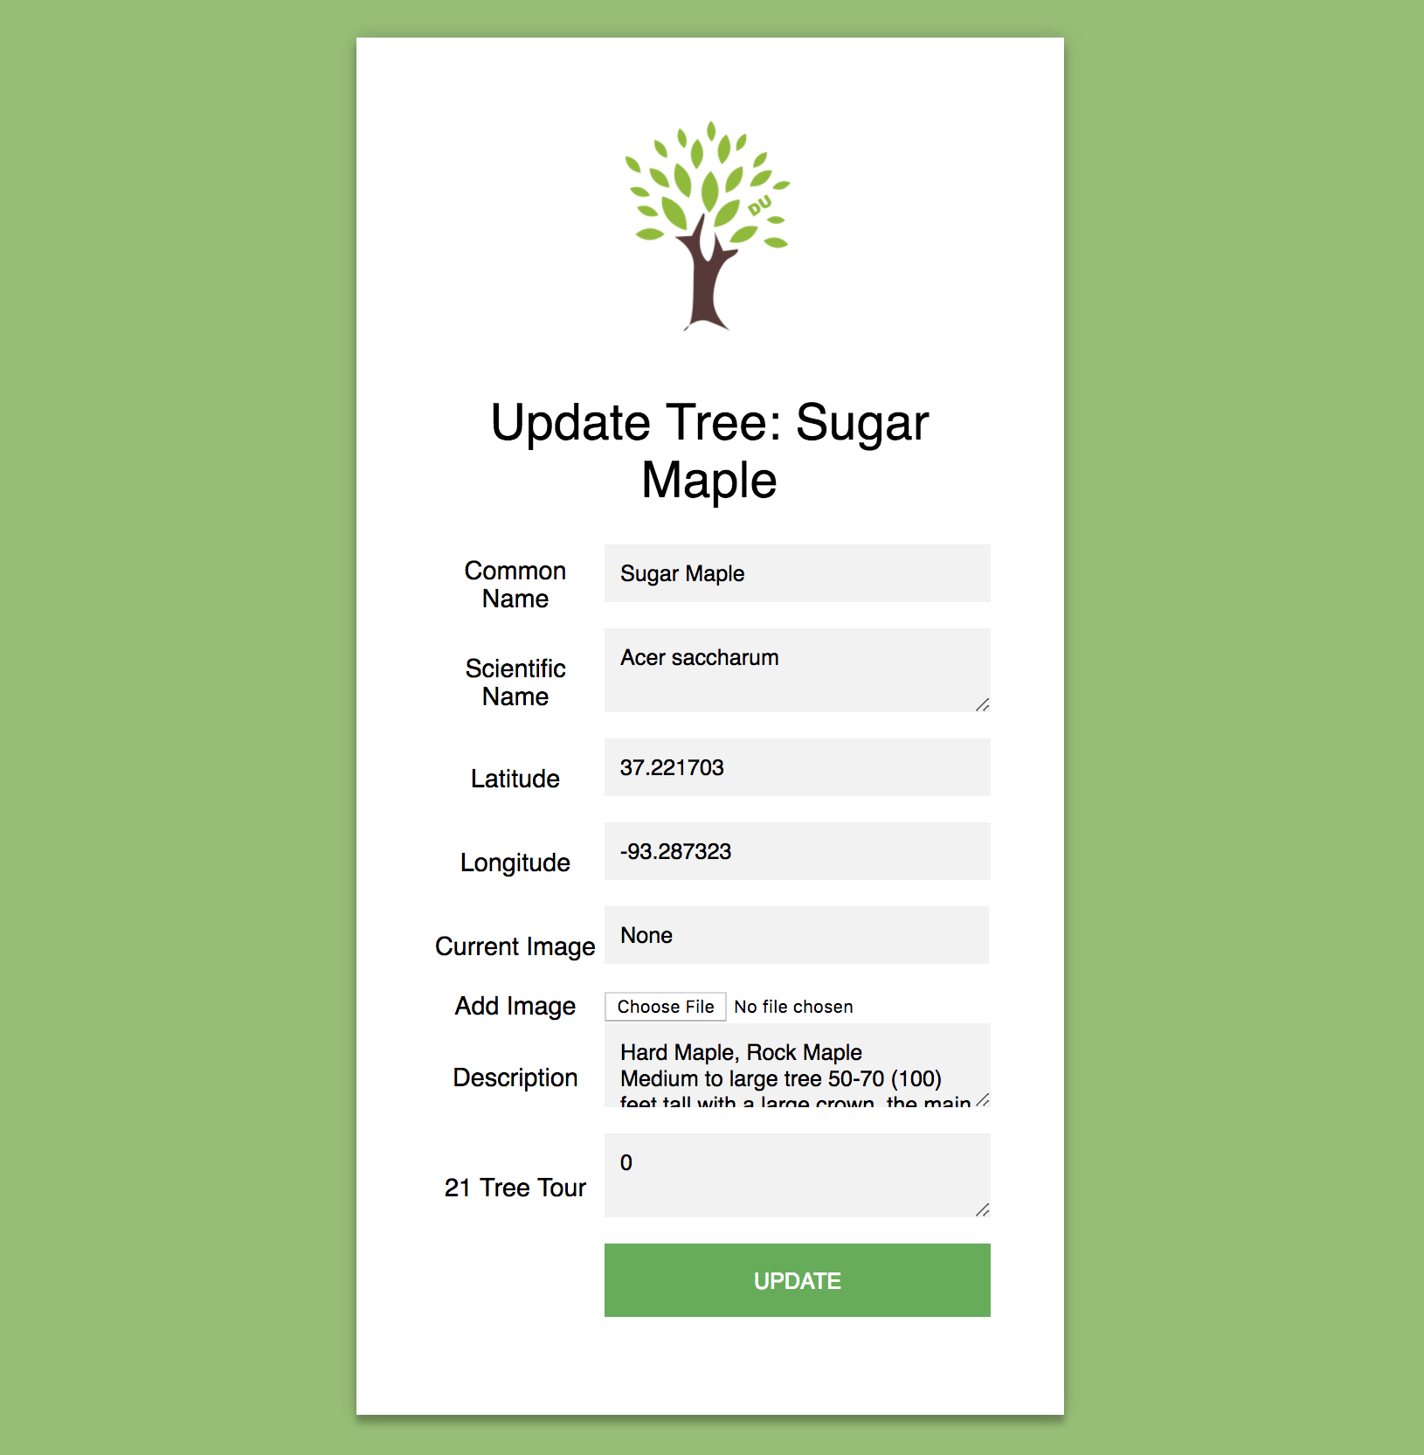

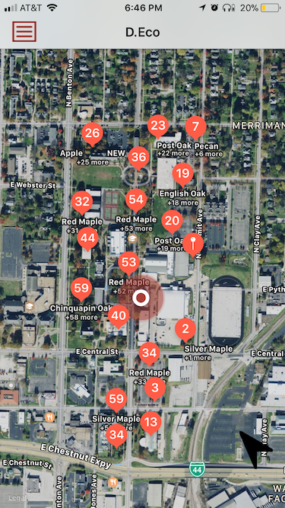
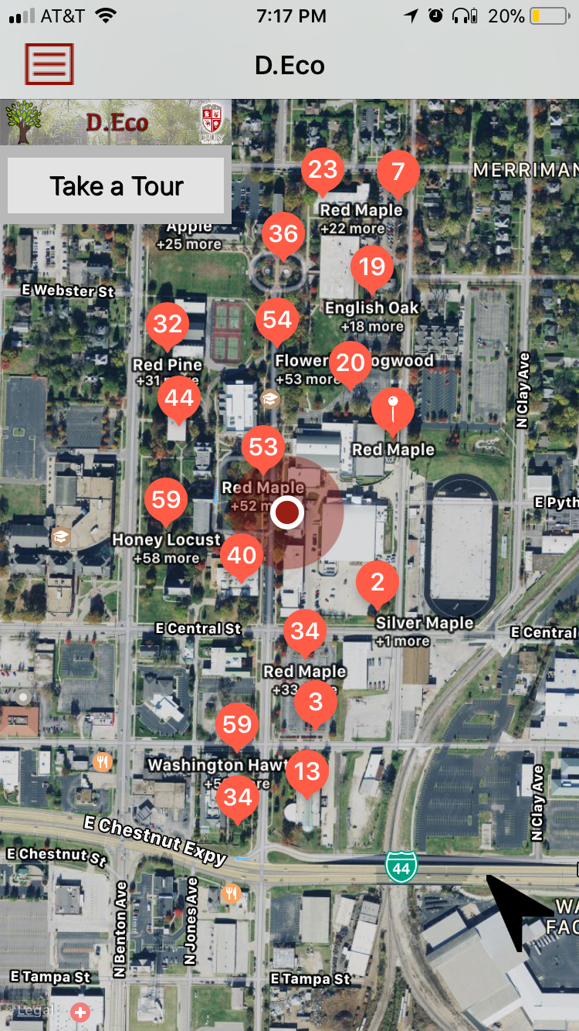
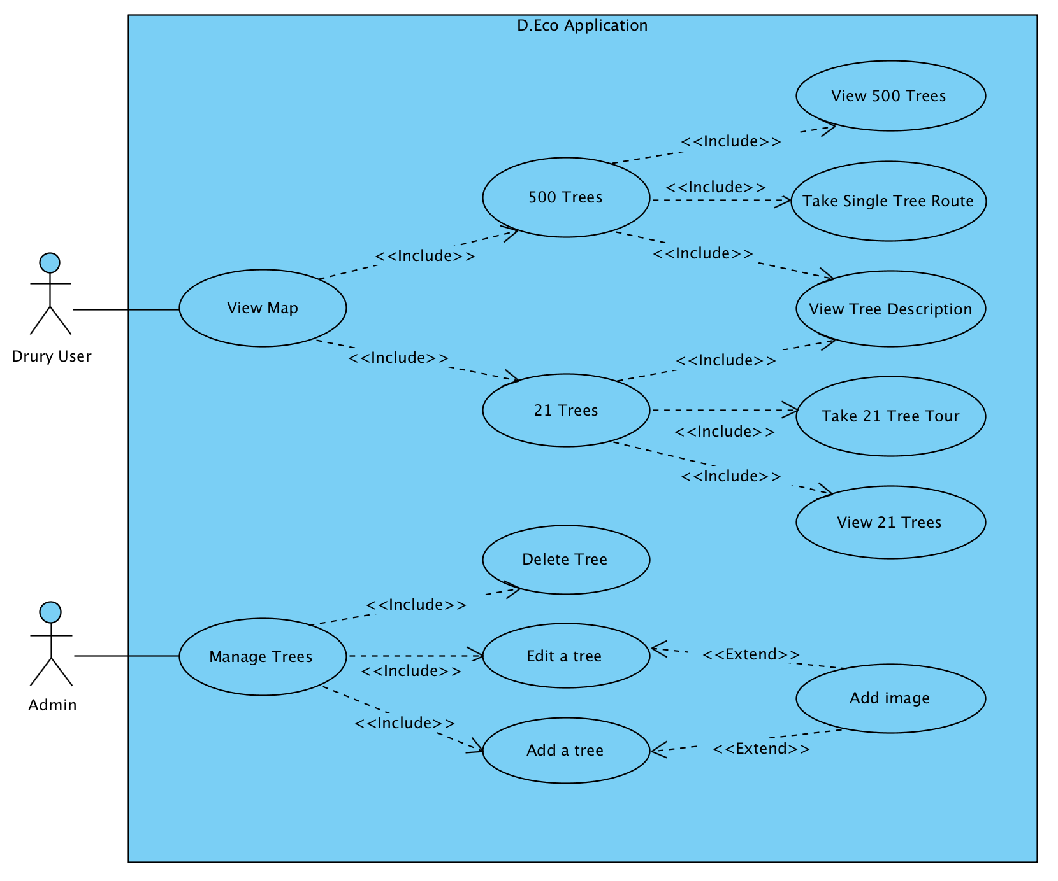
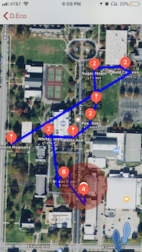
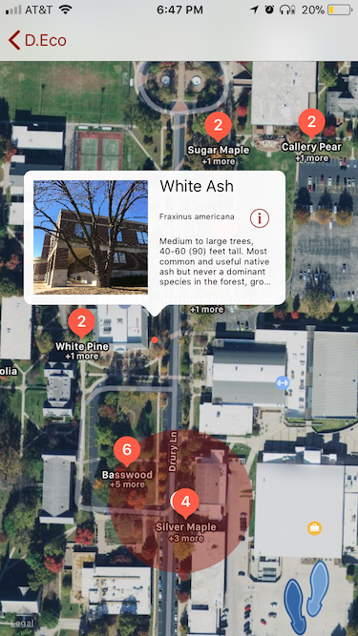
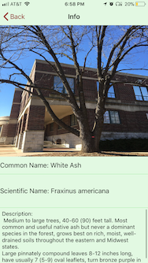
D.Eco
Students: Faisal Alsabhan, Kylie Pfaff, Cory Harris, and Morgan Brown | Mentors: Dr. Sigman and Dr. Branton
Purpose
Architecture
Administration Web Page
Android and iOS application that allows students, faculty, and visitors to tour the trees on Drury University’s campus
Educate and engage users by providing an interactive way to learn about the trees on campus
Functionality
A user can view a map of the campus with the 500+ annotation points that represent every tree currently documented on campus
A user can take a specific tour of the campus’ 21 unique tree species
While on the 21 Tree Tour, the user can view a specific tree’s description page which includes the common name, scientific name, short description, and an image of the tree
Interface
Requirements
Technologies
iOS
Swift - Xcode
Map Kit
Android
Java - Android Studio
Google Maps
Web Development
PHP - Apache
Amazon Web Services
Database
MySQL - Workbench
Future Direction
A user

